Slide 1
Broadcast Technology UG1
6: TV Standards, Colour Space
Jerry Foss
jeremy.foss@bcu.ac.uk

Slide 2
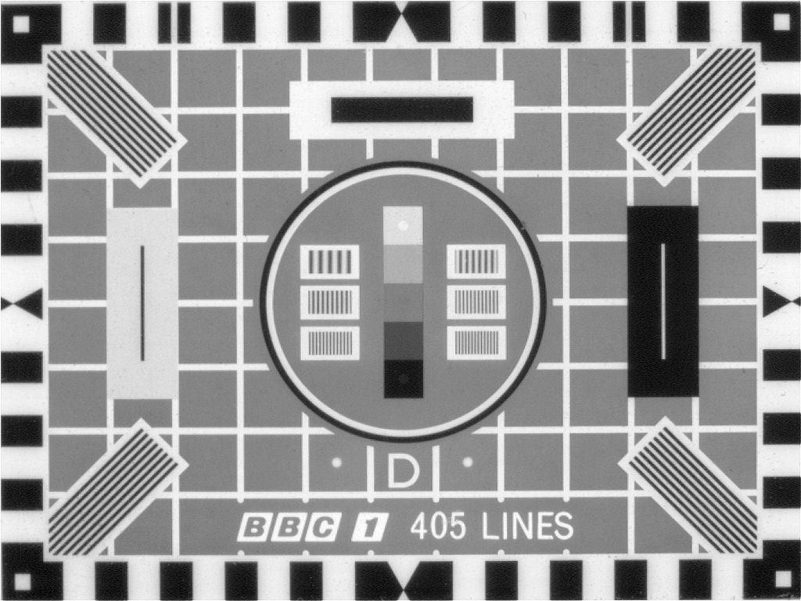

Slide 3
TV Broadcast Standards (some of …)
Media Formats
MPEG 2, 4, A, I
H.264, 265
VP9 – AV-1
Transmission
DVB
SDI
IP
SDI on IP SMPTE 2022
Broadcasting
ITU BT.709, 2020, 2100 …
Over the air – traditional broadcast methods
legacy analogue – PAL, NTSC, etc
Cable - DOCSIS
DVB-C, T, S, I etc…
Network
ISO OSI 7 layer
MAC, Ethernet, IP, TCP, etc ….
ISDN, CCITT, etc
3G, 4G, 5G …
SDH, SONET
Workflow
MXF
LTO
SOA / IP
Semantics - RDF, OWL
Metadata - EBU Core, MPEG-I
SMPTE 2022, 2110, 2059,
AES-67
AMWA NMOS

Slide 4
Amplitude Modulation

Slide 5
Frequency Modulation

Slide 6
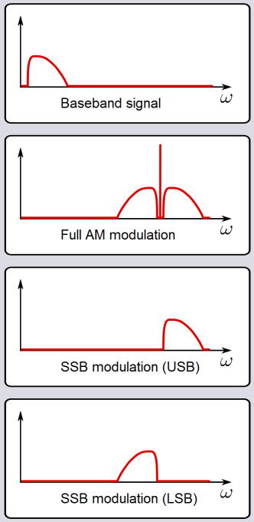
Sidebands – Single, Vestigial
SSB produced by filtering one of the sidebands, usually the lower (LSB)
Carrier is also often reduced or removed entirely (suppressed)
= single sideband suppressed carrier (SSBSC)
No information is lost in the process
Radio frequency transmission is now concentrated in a single sideband
∴ effective power output is greater than in normal AM
(since the carrier and redundant sideband account for well over half of the power output of an AM transmitter)
Requires special reception to demodulate

Slide 7
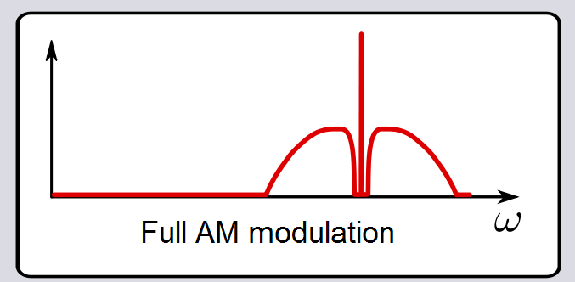
Vestigial Sideband (VSB)
sideband that has been only partly cut off or suppressed
to reduce the large bandwidth of the original video signal
also be used in digital transmission, such as the ATSC standardized 8-VSB
by the RF and IF filters
For video - SSB would be desirable
... but the video signal has significant low frequency content, plus square sync pulses
... so some of the lower sideband is retained
VSB - full upper sideband of bandwidth transmitted = 4MHz
... but only 1.25MHz of the lower sideband is transmitted, plus the carrier
effectively makes the system AM at low modulation frequencies and SSB at high modulation frequencies
absence of the lower sideband components at high frequencies must be compensated for, and this is done by the RF and IF filters

Slide 8
PAL-B Spectrum
AM information is normally distributed symetrically each side of the carrier
(see AM, later on, or UG1 notes)
therefore the bandwidth is normally twice the original signal
… this happens with audio radio, but audio is low b/w anyway, so little is wasted
Vision Carrier
Vision Carrier
However with video, this gives a big amount of “duplicated” bandwidth
So lower sideband is reduced to a “vestigial” sideband
Truncated Lower Sideband
Lower Sideband
Upper Sideband
frequency of carrier, say f_{c} = 400MHz
-2 -1 0 1 2 3 4 5 6
Frequency relative to carrier (MHz)

Slide 9
PAL-B Spectrum
Vision Carrier
Truncated Lower Sideband
-2 -1 0 1 2 3 4 5 6
Frequency relative to carrier (MHz)

Slide 10
PAL-B Spectrum
0 dB
Vision Carrier
Vision Information
Truncated Lower Sideband
-1.25
+5.75
-2 -1 0 1 2 3 4 5 6
Frequency relative to carrier (MHz)

Slide 11
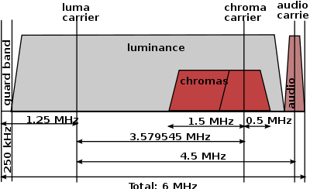
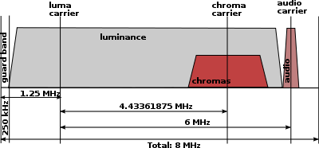
PAL, NTSC and SECAM
Spectra
NTSC
PAL
SECAM

Slide 12
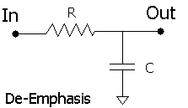
FM Sound Emphasis
dB
A FM subcarrier is added to the AM picture to carry the Audio information
FM Deviation 50 kHz, 50 us Emphasis
to overcome noise, typically in the high frequencies of baseband
de-emphasis at receiver
PAL-B uses 5.5 MHz Sound subcarrier (L+R)
2nd Sound subcarrier for Stereo (R)
Τ = R*C = 50μS
Frequency (Hz)

Slide 13
TV Modulation – AM; Min 20%
Peak White 20% Black 76% Syncs 100% Note – “Inverse modulation”
100%
76%
20%
0%
20%
76%
100%

Slide 14

The Analogue Video Signal
First Television Pictures were Black & White
Referred to as Luminance
Video refers to the linear base-band signal that contains the image information
Front Back Porch Porch
700 mV
0 mV
-300 mV
Sync Pulse
Sync Pulse

Slide 15

TV Modulation – PAL, AM
Colour signal added to AM signal
next line:
sync
sync
col burst
active video …………………………
col burst
active video …………………………
100%
76%
20%
0%
20%
76%
100%

Slide 16
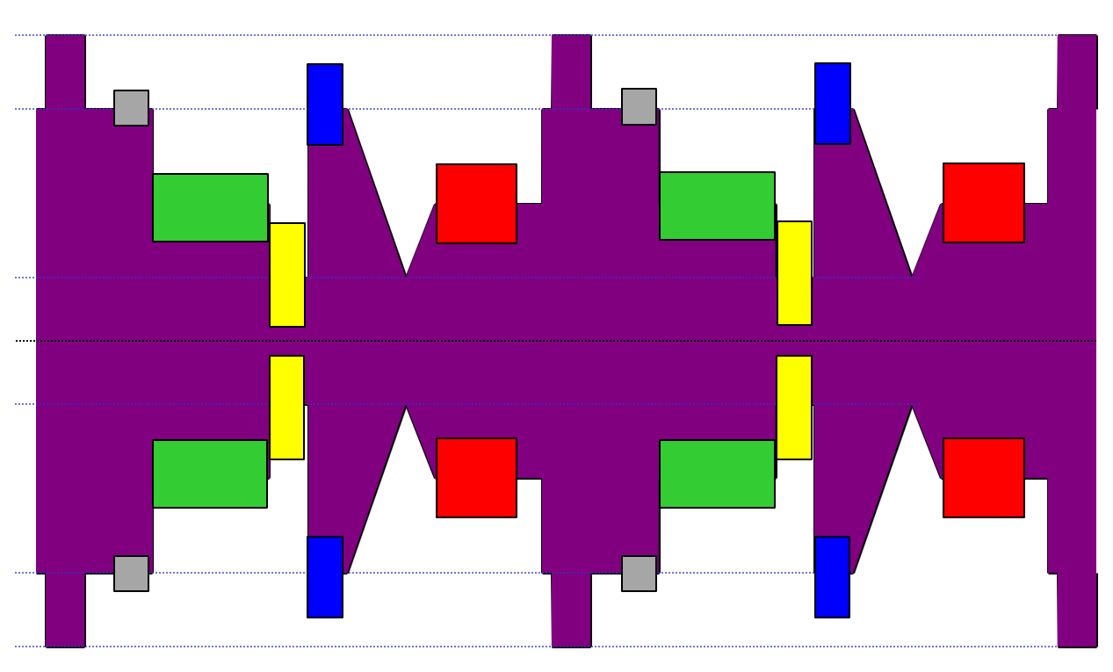
TV Modulation – PAL, AM
Sync pulse
Colour burst
Line n
Line n+1

Slide 17
Video Timing
SDTV
64 us for each line (15.625 kHz)
52 us Active Picture Area
12 us Blanking and Synchronisation
Two level sync pulse 300 mV below blanking
Active Picture 52 us
Line Blanking 12 us
700 mV
0 mV
-300 mV
Sync 4.7 us
1 Line = 64 us

Slide 18
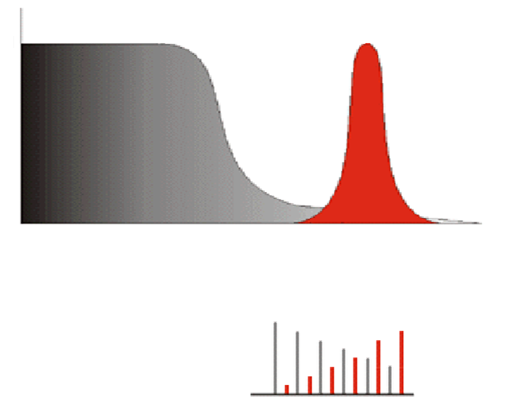
Colour Sub Carrier
Amplitude
Luma, Y
Chroma, U & V
Colour Sub-Carrier at 4.43361875 MHz
0 1 2 3 4 5
Freq, MHz
Frequency selected to interleave colour information spectra with Luma spectrum

Slide 19
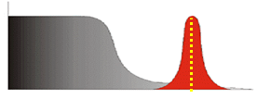
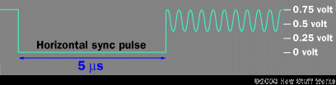
Adding Colour to B&W Video
Following Sync pulse, eight cycles of a sine wave are added as a colour burst to sync colour carrier (suppressed) to decode colour info. Carriers:
NTSC = 3.579545 MHz
PAL = 4.433618.75 MHz
colour burst

Slide 20
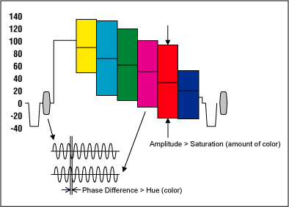
PAL Colour Encoding
Color | Phase
Burst | 0 degrees
Yellow | 15 degrees
Red | 75 degrees
Magenta | 135 degrees
Blue | 195 degrees
Cyan | 255 degrees
Green | 315 degrees
The hue of a given point on the screen
defined by the phase of the subcarrier at that point
with reference to the phase of the carrier insertion oscillator
which is synchronised to a burst of subcarrier at the start of each line
Hue errors
when the phase of the colour subcarrier has shifted during transmission with respect to the phase of the reference burst.
https://www.maximintegrated.com/en/app-notes/index.mvp/id/734

Slide 21
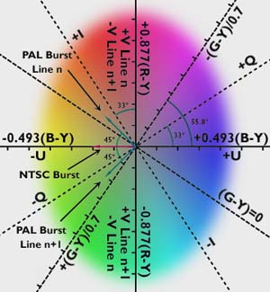
PAL Colour Encoding
Phase shift of the carrier in accordance with the PAL colour bar signal measured vector standard

Slide 22
PAL vs NTSC Colour
NTSC
colour instabilities due to multipath reception and transmitter imperfections
receivers needed a hue control to compensate
PAL early 1960's - developed to avoid NTSC issues
increased bandwidth - better picture quality
to correct shifts in the colour sub-carrier phase of the signal
every other line has its phase in reverse order = Phase Alternate Line
aimed to keep out non-European manufacturers from the TV set market
Japanese managed to design decoders which circumvented the PAL patents by treating the signal like NTSC but decoding only every other line
France - SECAM - sequential couleur avec memoire (sequential color with memory)
same bandwidth as PAL; transmits the colour information sequentially.
Eastern Block adopted for purposeful incompatibility with western transmissions (politics)

Slide 23
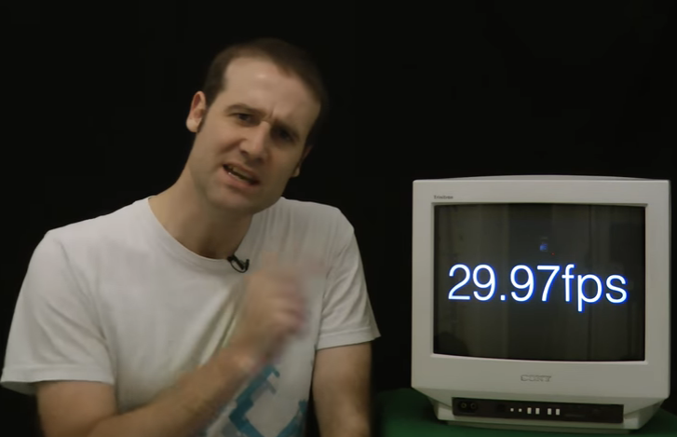
NTSC – why 29.97 fps?
.. and how did PAL get it right?
Matt Parker explains …
https://www.youtube.com/watch?v=3GJUM6pCpew

Slide 24
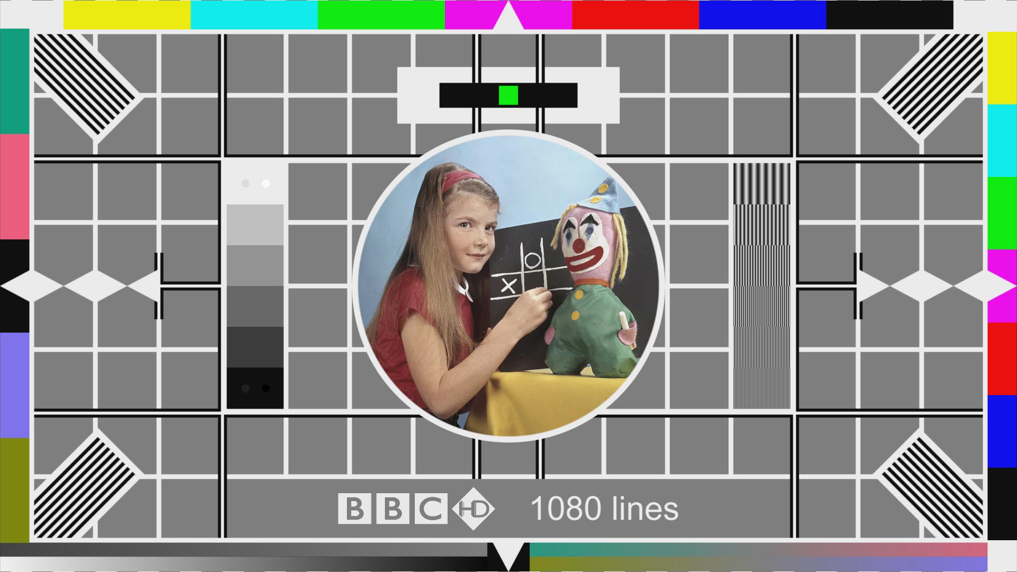
Standardising Colour
Standardising TV formats
Recs BT.709, BT.2020, BT.2100
Standardising Colour
Standardising TV formats
Recs BT.709, BT.2020, BT.2100

Slide 25
RGB Colour Space
variety of standards for mapping colour
most popular –
CIE 1931 - widely used
CIE 1976 - strongly advised
CIE - Commission internationale de l’éclairage
Gamut - the achievable colours in the colour space;
Chromaticity diagrams
measure colour quality, independent of other factors like luminance
colour space is a uniform representation of visible light
maps the all of the colours visible to the human eye onto an x-y grid
assigns them measureable values
allows uniform measurements and comparisons between colours
offers certainty that images look the same from display to display when used to create colour gamut standards

Slide 26
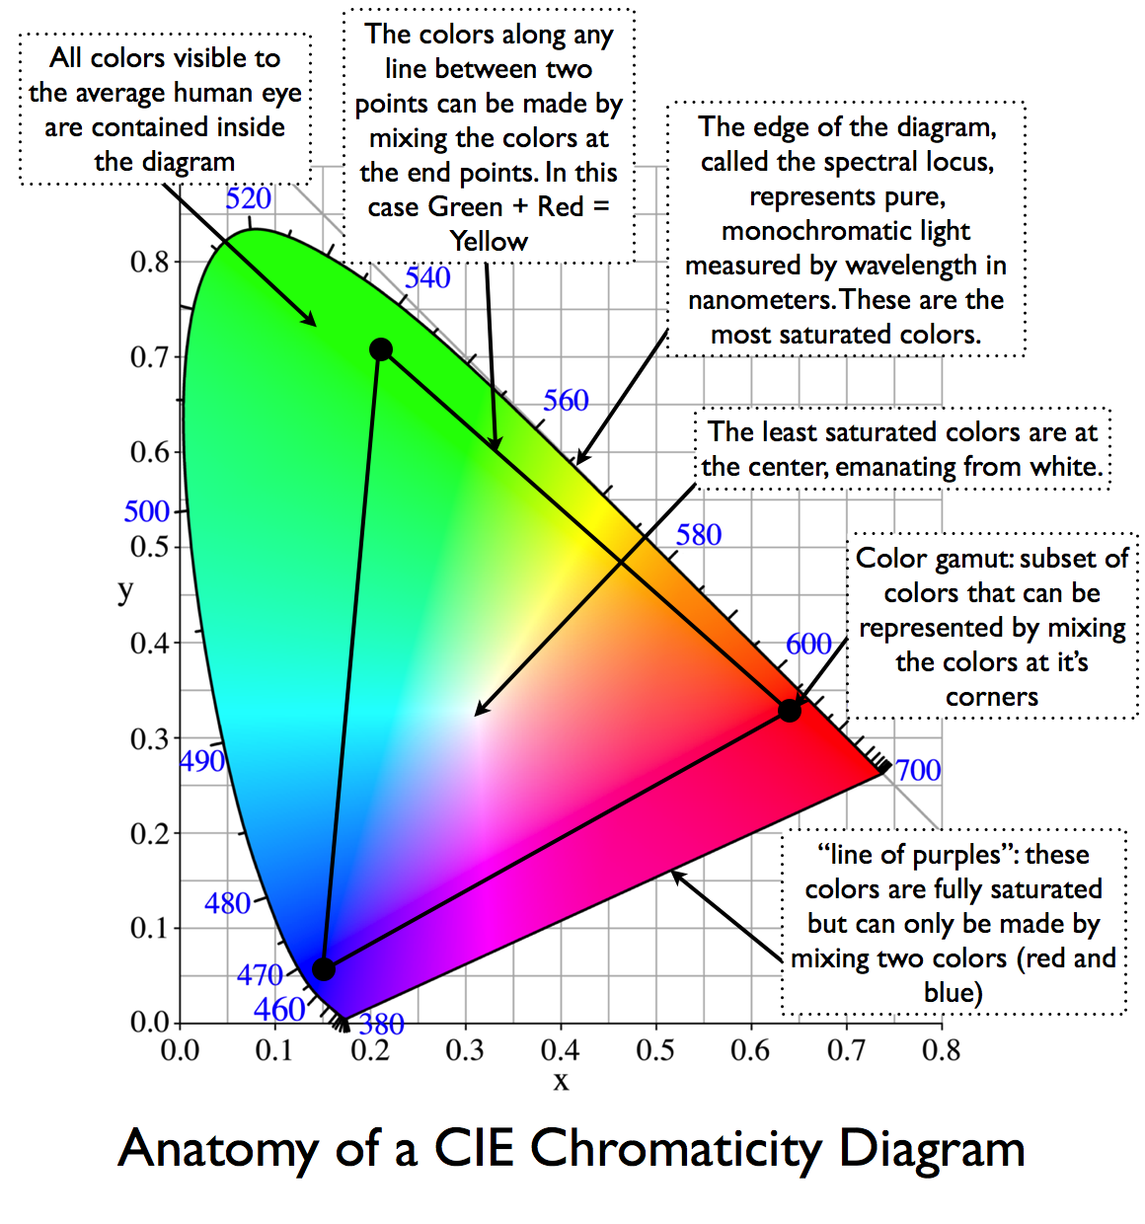
RGB Colour Space
CIE Chromaticity Diagram
http://dot-color.com/tag/cie-1931/

Slide 27
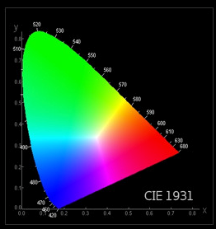
Chromaticity and CIE Colour Space
Rec. 709 - for monitors, not cameras
defines a gamma of 2.2
CIE spaces
Colours defined by their coordinates on a CIE chromaticity diagram
diagram deals with hue and saturation, not brightness; colour defined by two numbers
R: xR = 0.64 yR = 0.33
G: xG = 0.30 yG = 0.60
B: xB = 0.15 yB = 0.06
also defines
white: xW = 0.3127 yW = 0.3290
establishes the effective colour temperature of the display
e.g. rec 709 cannot display a green deeper than 0.3, 0.6 on CIE 1931

Slide 28
BT.709
HDTV systems 2M luma samples / frame.
Rec. 709 two parts:
1080i and 1080p systems
1035i30 and 1152i25 HDTV systems
1035i30 now obsolete; 1152i25 experimental, never commercially deployed
Frame Rate
picture rates: 60 Hz, 50 Hz, 30 Hz, 25 Hz and 24 Hz.
"Fractional" rates (divided by 1.001) also permitted
Digital Representation
R’G’B’ and Y’CBCR
8 or 10 bits per sample in each color channel
8-bit encoding: R’, B’, G’, and Y’ channels range of 16 ... 235
Cb, Cr channels = 16 ... 240 (128 = neutral value)
R’G’B’ - reference black = 16, 16, 16; reference white = 235, 235, 235
Y’CbCr - reference black = 16, 128, 128; reference white = 235, 128, 128
Values outside nominal ranges allowed, but usually clamped for broadcast
0 and 255 = timing references
For 10-bit encoding – 4 x (8-bit encoding values)
… [i.e. 2 extra bits = 4x]

Slide 29
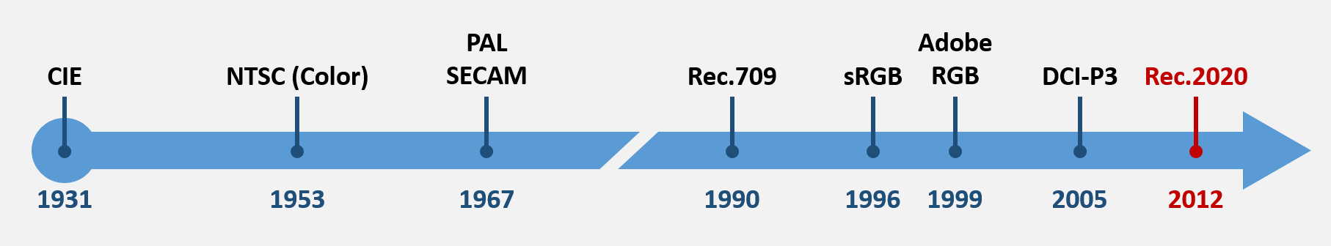
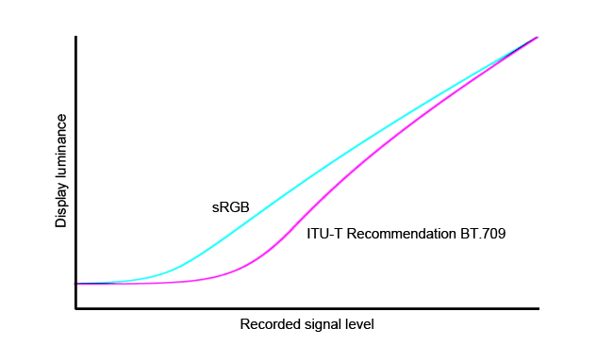
Colour Standards
NTSC / PAL / SECAM … CIE Coverage: 47%
primary standards since 1950s for analogue broadcasting
largely phased out due to digital HD broadcasting.
http://www.redsharknews.com/technology/item/3289-what-exactly-is-rec-709
Rec BT.709 … CIE Coverage: 34%
1990, ITU; predominate standard for digital HD broadcasting and TVs
(also DVD and Blu-ray)
standard for HD format, aspect ratio, 709 colour space
actually covers less of the CIE than the NTSC
Rec. 709 gamma curve, shown here in comparison to the sRGB curve used on computers.

Slide 30
Colour Standards
sRGB … CIE Coverage: 34%
1996, HP and Microsoft
colour gamut identical to Rec.709
most commonly used standard worldwide for just about every device other than TVs
for internet streaming, monitors, projectors, cameras, printers, game consoles, smart phones, tablets, touch screen, etc
Adobe RGB … CIE Coverage: 50%
1999, Adobe
to address accurately matching display colour with CMYK printing color
now increasingly preferred in creative industries due wider gamut than sRGB.

Slide 31
Colour Standards
DCI-P3 … CIE Coverage: 46%
2005, consortium of cinema, television and entertainment companies
to ensure consistent content quality from original capture to final projection.
preferred in creative industry due to emphasis on digital production and distribution
used in cinema-grade cameras, projectors and projection equipment

Slide 32
Colour Standards
Rec. BT 2020 … CIE Coverage: 67%
2012, ITU; optimized for UHD. Covers many aspects, including wide colour gamut
68 billion colours.
NHK - 2020 Olympics in full Rec.2020 colour
Blu-Ray Disc Association - Rec.2020 for Ultra HD Blu-Ray
Consumer Electronics Association (CEA) - definition of HDR - reference to Rec. 2020 primaries in its HDR10 Media Profile
resolution, frame rates, etc – BT.2100 expands on 2020 .. see over …

Slide 33
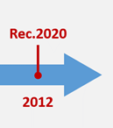
Colour Standards
Rec.2100
2116
BT.2100 – expands on BT.2020 (resolutions and colour gamut)
2016, ITU
resolution: 1080p (x 1920); 3840 × 2160 (i.e. 4K); 7680 × 4320 (i.e. 8K)
square pixels
frame rates: 120p, 119.88p, 100p, 60p, 59.94p, 50p, 30p, 29.97p, 25p, 24p, 23.976p
only progressive scan frame rates
bit depth: 10 or 12
narrow range colour or full range colour:
10 bit (i.e. 0 – 1023), full range – all levels 0-1023
same colour space as BT.2020

Slide 34
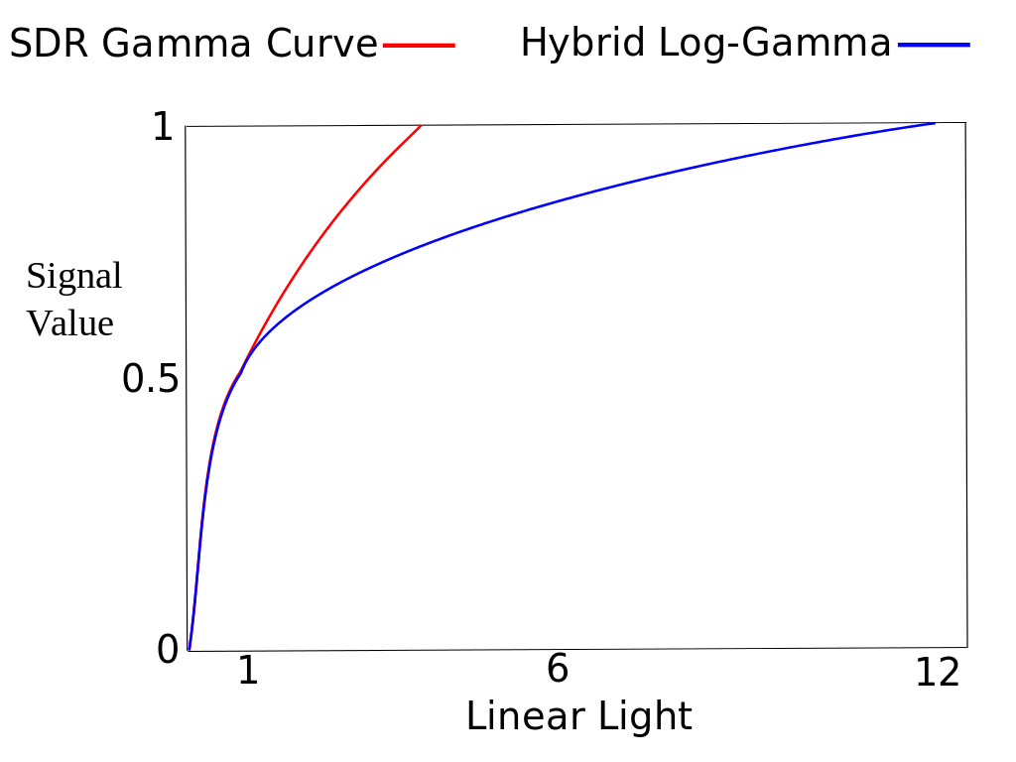
Colour Standards
Rec.2100
2116
Two transfer function formats
Perceptual Quantisation (PQ)
more prevalent in the consumer equipment
HDR10 and Dolby Vision
Hybrid Log-Gamma (HLG)
BBC, NHK
compatibility with legacy SDR displays
closely matches established television gamma systems

Slide 35
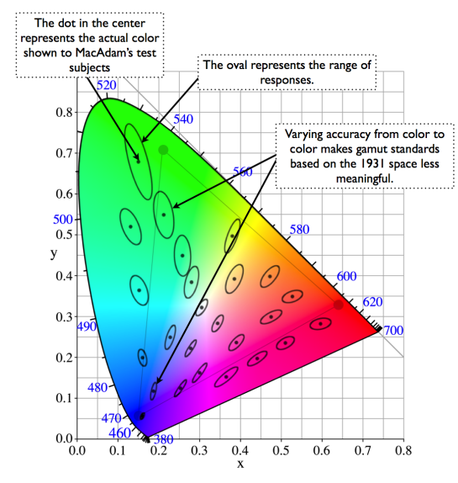
CIE1931 vs CIE1976
MacAdam (in mid 1970’s)
“ … CIE 1931 not linear, e.g.
green – wide perceived range of hues of green
blue - much more agreement
MacAdam Ellipses
ellipse = the range of colours respondents reported
... so CIE1976
more linear colour space

Slide 36
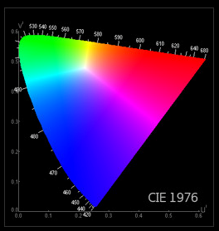
CIE1931 vs CIE1976

Slide 37
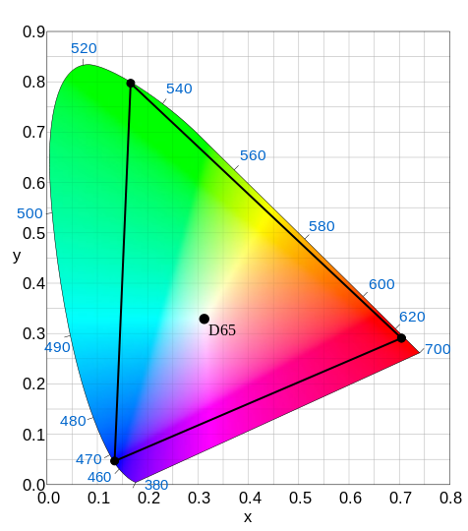
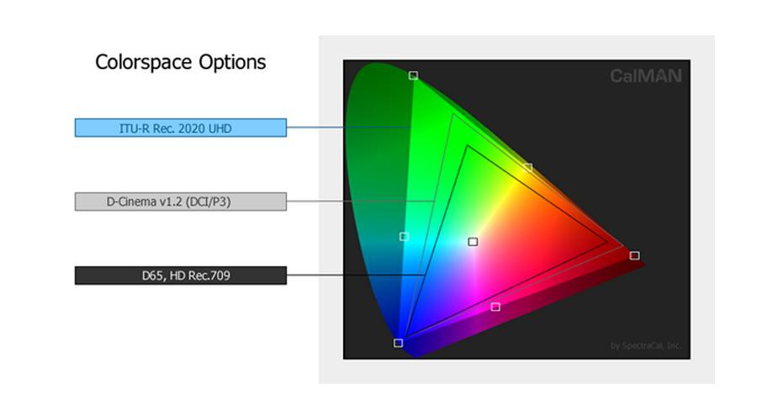
ITU Rec 2020
ITU-R Rec BT.2020
August 2012
defines aspects of UHDTV:
resolution
frame rate
chroma subsampling
bit depth
colour space
white ref is D65
~6500K
https://www.avforums.com/article/ifa-2014-joe-kane-interview-about-ultra-hd-4k-tv.10702

Slide 38
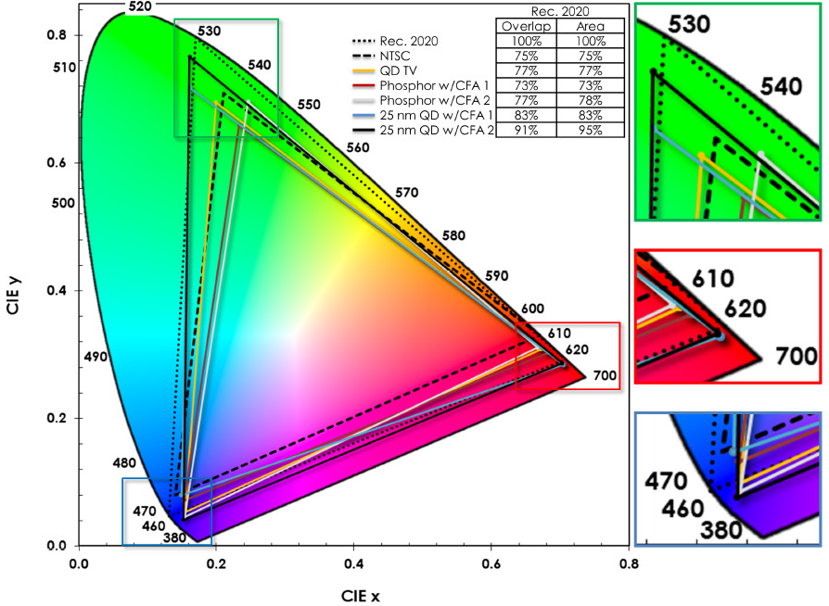
QD / WCG Gamut
WCG = Wide Colour Gamut
QD: Quantum Dot Displays
QD - tunable, pure colour
very narrow emission spectra
tuned to wavelength by quantum dot size
better control of the colour gamut than phosphor LEDs
Phosphor and QD primaries plotted against Rec.2020 and NTSC reference gamuts
http://www.display-central.com/subscription-news/editorial-categories/flat-panel/qd-vision-3m-find-advantages-in-quantum-dots-not-surprisingly/

Slide 39
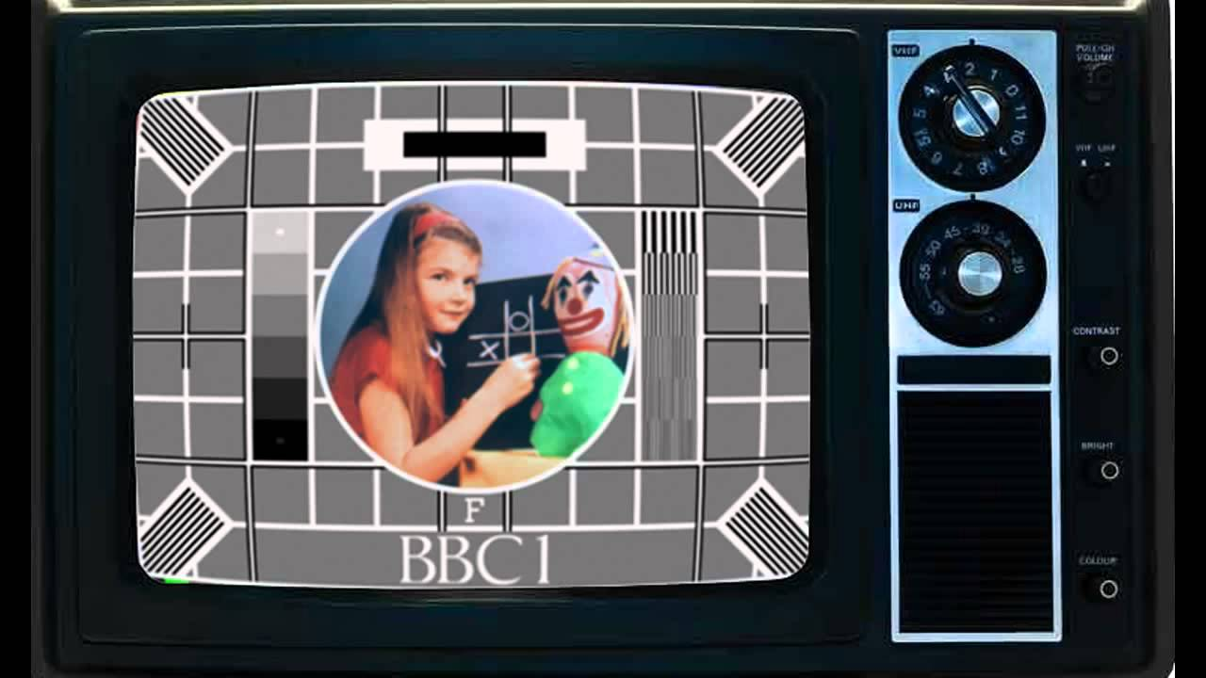
Additional Slides

Slide 40
Colour Encoding
QAM subcarrier carrying the chrominance
added to the luminance video signal > composite video baseband signal
freq subcarrier =
4.43361875 MHz for PAL, NTSC 4.43
3.579545 MHz for NTSC 3.58
SECAM: FM on two line alternate colour subcarriers 4.25000 and 4.40625 MHz
Phase Alternating Line
phase of part of the colour information on the video signal is reversed with each line
automatically corrects phase errors in the transmission of the signal by cancelling them out
at the expense of vertical frame colour resolution
receivers use a chrominance analog delay line
- stores the received colour information on each line of display
- an average of the colour information from the previous line and the current line is then used to drive the picture tube
- effect - phase errors result in saturation changes - less objectionable than hue changes of NTSC
- drawback i- vertical colour resolution is poorer than NTSC
- human eye colour resolution lower than brightness resolution - PAL effect is not visible
- also - chroma subsampling used

Slide 41
Colour Encoding
Colour carrier
4.43361875 MHz frequency
due to 283.75 colour clock cycles per line
+ 25 Hz offset to avoid interferences.
line frequency = 15625 Hz (625 lines × 50 Hz ÷ 2)
colour carrier frequency:
4.43361875 MHz = 283.75 × 15625 Hz + 25 Hz.
original colour carrier is required by the colour decoder to recreate the colour difference signals
Since the carrier is not transmitted with the video information it has to be generated locally in the receiver.
phase needs to match the transmitted information
so 10 cycle burst of colour subcarrier is added to the video signal shortly after the line sync pulse … colour burst
not in phase with the original colour subcarrier:
leads by 45 degrees on the odd lines
lags it by 45 degrees on the even lines
… this enables the colour decoder circuitry to distinguish the phase of the [R-Y] vector which reverses every line.

Slide 42
Staircase Test Signal
descending staircase
peak white >> black
luminance is unipolar ... no concept of negative brightness
luminance signal subtracted from the red and blue components
differences .. these signals are bipolar
Vectorscope
B-Y causes horizontal deflection
R-Y causes vertical deflection
... display having six peripheral dots and two central dots.
central dots
white and black bars - not colours - colour difference signals are both zero

Slide 43
Quadrature Modulation
Colour bar test signal is generated
RGB square waves of identical amplitude are produced
one cycle fits in the active line of the green signal
two cycles fit in the active line of the red signal
four cycles fit in the active line of the blue signal
eye - non-uniform response to colours
R, G and B components are weighted before being added

Slide 44
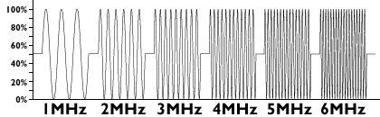
PAL Colour Encoding
Waveform of a multiburst test signal
ranges from black (0%) to white (100%) with a mean level of 50%
http://www.pembers.freeserve.co.uk/World-TV-Standards/

Slide 45
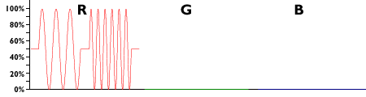
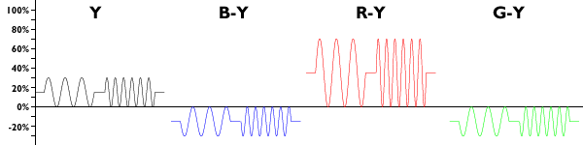
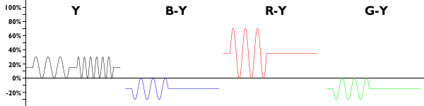
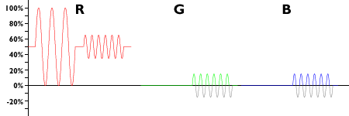
PAL Colour Encoding
Multiburst entirely in one primary colour
shown - one grating that is within the chrominance passband followed by one that is outside it
signal is applied to the red channel only, so the green and blue channels are at black level (0%).
The luminance and the three colour-difference channels
Adding together the luminance and each of the colour difference signals in turn will give the same R, G and B signals as above.
However, the chrominance channels are low-pass filtered
The lower frequency grating remains unchanged, but the higher one becomes a straight line having the same mean level as the grating.
When the luminance signal is added to each colour-difference signal, the amplitude of the high-frequency grating is reduced in the active channel
phantom gratings appear in the other two channels, reducing the saturation (and fortuitously increasing the brightness slightly) of the details.
The red and green channels contain negative-going information which will either be clipped by the display circuitry or cut off in the TV

Slide 46


PAL Colour Encoding
The loss of luminance resolution is less pronounced in areas of saturated green and more pronounced in saturated blue because of the relative contributions made by the colour separation signals to the luminance signa
This sequence of screenshots shows the two sections of multiburst as a black-and-white signal...
..as a signal in the red channel only as displayed on an RGB monitor before encoding...
..and as displayed after decoding.

